Slide 1
Lecture 10: Floorplan – II
Tsung-Wei (TW) Huang
Department of Electrical and Computer Engineering
University of Utah, Salt Lake City, UT
Notes:
Today we are going to continue on our journey to floorplan. We are going to talk about another very amazing floorplan representation called sequence pair.

Slide 2
Recap: Floorplanning
I/O Pads
Floorplan
Module a
Module b
Block a
Block c
Module c
Floorplanning
GND
VDD
Block d
Block Pins
Module d
Block b
Block e
Module e
Partitioned modules (e.g., FM algorithm)
Supply Network
Notes:
Let’s refresh our memory again on floorplan. Given a set of partitioned modules, you know, by running your FM to break the circuit into several pieces, the goal of floorplan is to pack these modules as close to each other as possible, and we want to minimize the estimated wirelength and the packed area.

Slide 3
Recap: Slicing Floorplan
Slicing floorplan
One that can be obtained by repetitively subdividing (slicing) rectangles horizontally or vertically
Non-slicing floorplan
One that may not be obtained by repetitively subdividing alone
Slicing floorplans are much easier to handle
Efficient data structures exist for efficient computational manipulations
Slicing Floorplan
Non-slicing Floorplan
Notes:
Last time we talk about two different types of floorplans, slicing floorplan and non-slicing floorplan. (explain …)
Since slicing floorplans are much easier to handle, we talk about an efficient data structure to represent slicing floorplans.

Slide 4
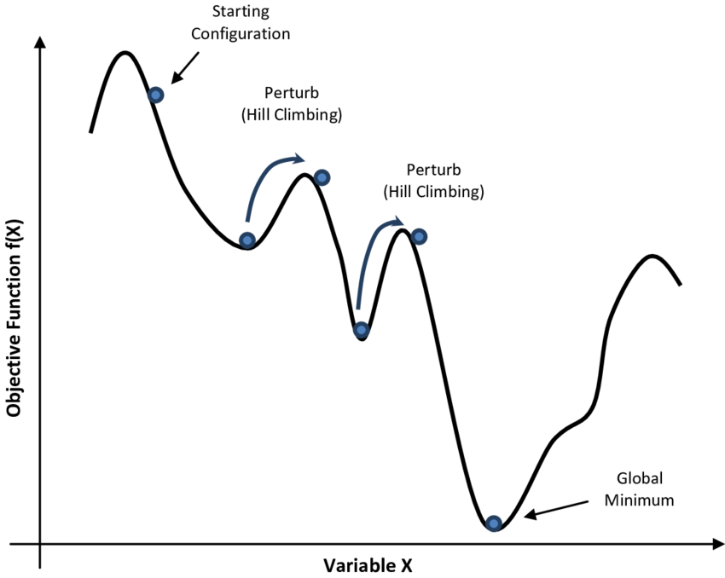
Big Idea in Floorplan Optimization
Design efficient linear state representation for 2D layout
Polish expression (PE) for slicing floorplan
Apply SA to optimize state search problem
Slicing Tree
V
Slicing Floorplan
3
H
H
1
2
1
H
3
4
5
V
V
2
6
7
6
7
4
5
21H67V45VH3HV
Notes:
That is the big idea in floorplan optimization. We discussed a very efficient linear state representation for a 2D layout using a polish expression for slicing floorplan. A polish expression is essentially a post-order traversal of a slicing tree, and we know a slicing tree is a binary tree such that all internal nodes are operators (V or H), and all leaf nodes are modules. For example (explain …)
With this 1D expression in place, we can apply SA to optimize state search problem.

Slide 5
Simulated Annealing-based Optimization
1
Each move gives a new floorplan result
Key idea: Leverage simulated annealing to optimize moves
1
M1
2
4
5
5
3
4
3
2
34V2H5V1H
32V4H5V1H
M3
1
1
4
5
5
M2
3
2
3
2
4
32V45VH1H
32V45HV1H
Notes:
We can iteratively apply different moves to change the 1D polish expression sequence, and each move will give us a new floorplan result. For example, we can swap one module with an operator, as M1 here, swap adjacent operator and module, as M3 here, or complement H and V as M2 here. We can see that each of the move changes the sequence, the 1D sequence, which in turn changes the 2D layout.
(explain SA)

Slide 6
Sequence Pair
H. Murata, K. Fujiyoshi, S. Nakatake and Y. Kajitani, “VLSI module placement based on rectangle-packing by the sequence-pair,” in IEEE TCAD, vol. 15, no. 12, pp. 1518-1524, Dec. 1996
One of the most influential papers in the computer design industry
Widely used by industrial tools
Sequence pair is a succinct representation of non-slicing floorplan
Just like PE for slicing floorplan
Leverage SA to find a good sequence pair for floorplan optimization
Notes:
Any question so far?
We have learned that we can represent a slicing floorplan in a slicing tree and optimize the area and wirelength in one dimension. However, slicing tree and 1D polish expression can only handle slicing floorplan. You know, the floorplan that can be obtained by recursively applying vertical and horizontal cuts.
What about the general floorplan? Or non-sliceable floorplan. So, next, we are going to talk about another floorplan representation, called sequence pair. This is a very amazing representation proposed by Dr. Murata when he was a PhD in UC Bekerley in 1996. The paper is VLSI module … (explain…)

Slide 7
Sequence Pair (cont’d)
Positive sequence: lower-left to upper-right, i.e., ecafdb
Negative sequence: upper-left to lower-right, i.e., fcbead
e
e
d
a
d
a
Positive
c
Negative
c
f
f
b
b
Notes:
What is a sequence pair? A sequence pair consists of two sequences, a positive sequence and a negative sequence. The positive sequence represents each module in a line from lower-left to upper-right, and different lines between modules should not overlap. Then, you come up with the order of these lines. For example, here I have six modules laid out here (explain …)
So, that is the positive sequence. Similarly, a negative sequence represents each module in a line from upper-left to lower-right, and different lines between modules should not overlap. Then, you come up with the order of these lines. For example, (explain…)

Slide 8
Positive Sequence Construction
To go from a floorplan to its sequence pair, we first draw up-right steplines for each module as follows:
Starting from the upper right corner of a module until we reach the upper right corner of the floorplan, we draw vertical lines (going up) and horizontal lines (going right) in an alternative fashion so that we don’t cross any module boundary in the floorplan and any previously drawn line
We also draw down-left steplines in a similar way but in an opposite direction
Negative Sequence can be constructed in a similar way
Notes:
To go from a floorplan to its sequence pair, specifically, the positive sequence, we first draw … (explain)

Slide 9
Positive Sequence Construction
Positive stepline sequence: e
e
a
d
c
f
b
Notes:
Let’s walk through how we can draw the stepline for this example of six modules.
Keep in mind we are starting from the upper right corner of a module until we reach the upper right corner of the floorplan. We go up and right and don’t cross any previous lines.
(explain …)

Slide 10
Positive Sequence Construction
Positive stepline sequence: ec
e
a
d
c
f
b

Slide 11
Positive Sequence Construction
Positive stepline sequence: eca
e
a
d
c
f
b

Slide 12
Positive Sequence Construction
Positive stepline sequence: ecaf
e
a
d
c
f
b

Slide 13
Positive Sequence Construction
Positive stepline sequence: ecafd
e
a
d
c
f
b

Slide 14
Positive Sequence Construction
Positive stepline sequence: ecafdb
e
a
d
c
f
b

Slide 15
Negative Sequence Construction
Negative stepline sequence: f
e
a
d
c
f
b
Notes:
Let’s follow the same procedure to draw the steplines for negative sequence.
For negative sequence, we are starting from the upper left corner of a module until we reach the upper left corner of the floorplan, we draw vertical lines (going up) and horizontal lines (going left) in an alternative fashion so that we don’t cross any module boundary in the floorplan and any previously drawn line. We also draw right steplines in a similar way but in an opposite direction
(explain …)

Slide 16
Negative Sequence Construction
Negative stepline sequence: fc
e
a
d
c
f
b

Slide 17
Negative Sequence Construction
Negative stepline sequence: fcb
e
a
d
c
f
b

Slide 18
Negative Sequence Construction
Negative stepline sequence: fcbe
e
a
d
c
f
b

Slide 19
Negative Sequence Construction
Negative stepline sequence: fcbea
e
a
d
c
f
b

Slide 20
Negative Sequence Construction
Negative stepline sequence: fcbead
e
a
d
c
f
b

Slide 21
Sequence Pair Property
The authors showed that the positive/negative sequence of modules always exist and do not cross each other
e
e
d
a
d
a
ecafdb
c
c
fcbead
f
f
b
b
Notes:
For any floorplan, we can always draw such lines to construct a positive sequence and a negative sequence to form a sequence pair. The authors have shown that the positive and negative sequences of modules always exist, and they do not cross each other.
What is the deal for this? Why do we care? Let’s stop here for a few minutes and think about this: if I give you these two sequences, what can you do?

Slide 22
Geometric Info of a Sequence Pair
Given a sequence pair (P, N)
a is right to b, iff a is after b in both P and N
a is left to b, iff a is before b in both P and N
a is above b, iff a is before b in P and a is after b in N
a is below b, iff a is after b in P and a is before b in N
c is above f
a is right to c
b is below to e
…
Notes:
The key message behind the sequence pair is the geometric information it stores in just two 1D sequences. We know the positive sequence is a direction from lower left to upper right, and the negative sequence is a direction from upper left to lower right. And, think about this, if I tell you lower left, upper right, lower right, and upper left corners of a rectangle or a module, its position can be uniquely decided, right?
With the two sequences, I can decide a relative order between modules. So, given a sequence pair, P and N, we can uniquely decide the relatively order as follows: (explain )
For example, looking at the two sequences, what is the relative order of c and f.

Slide 23
Solution Perturbation
M1: swap a random pair of modules in the first sequence
(ecafdb, fcbead) → (eacfdb, fcbead)
M2: swap a random pair of modules in both sequences
(ecafdb, fcbead) → (edafcb, fdbeac)
M3: rotate a randomly selected module
(ecafdb, fcbead), (W_{c}, H_{c}) → (ecafdb, fcbead), (H_{c}, W_{c})
Wait … how to recover the floorplan from a sequence pair?
Notes:
Now, we can start perturbing the two sequences just like what we did in slicing floorplan to generate different floorplan results, and over these iterations we pick up the optimal one, the one that has the smallest area and shortest wirelength.
We define the following moves: (explain …)
But, wait a minute, how do we recover the floorplan from a sequence pair? (stop for 5 mins to think)

Slide 24

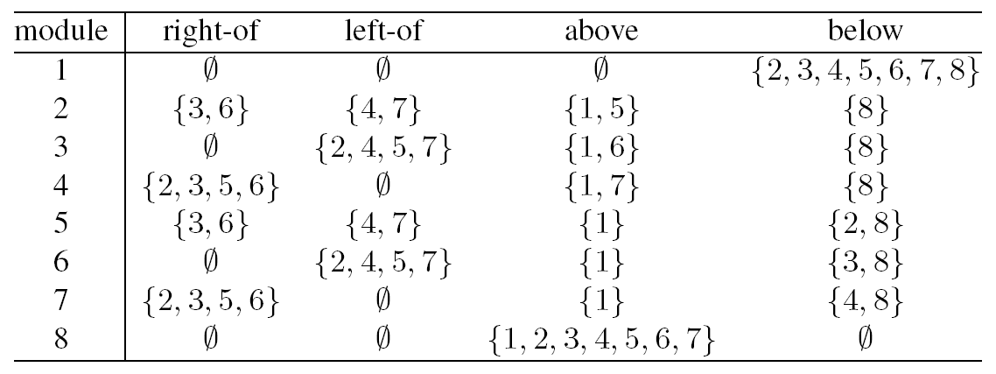
Relative Locations
SP = (17452638, 84725361)
Dimensions (W, H): (2,4), (1,3), (3,3), (3,5), (3,2), (5,3), (1,2), (2,4)
Notes:
To recover the floorplan from a sequence pair, we first find relative locations among modules. Remember we just convinced ourself that with such two sequences, we can decide whether a module is above or below another or a module is right or left to another.
Assume we have a sequence pair representing eight modules, here, positive sequence 17452638 (explain …)
Based on the sequence pair, we come up with this table that summarizes all the modules in the four directions to each module. For each module, I can write down what are the modules above it, below it, right to it, and left to it. For instance (explain …)

Slide 25
Module Locations on a Grid
Rotate 45 degree
Notes:
To decide the module location from this relative order table, we first draw a grid of dimension n by n, where n is the number of the modules in the floorplan. In this example, we have eight modules, so we draw a 8 by 8 grid.
Then (click), we rotate it by 45 degree.

Slide 26
Module Locations on a Grid
Positive sequence
(17452638)
1
1
7
6
4
3
5
5
2
2
6
7
Negative sequence
(84725361)
3
4
8
8
Notes:
And put positive sequence on the lower left side of the grid, negative sequence on the lower right side of the grid. (explain …)

Slide 27
Module Locations on a Grid
1
Positive sequence
(17452638)
7
5
6
1
1
4
2
3
7
6
4
3
5
5
2
2
6
7
Negative sequence
(84725361)
3
8
4
8
8
Notes:
For the cross point, we will put the module. For example, module will sit right here at the cross point from the number 1 in positive sequence and negative sequence.
(explain all other seven modules)

Slide 28
Horizontal Constraint Graph (HCG)
Add a directed edge m1→m2 if m2 is right to module m1
Notes:
Next, we are going to construct a graph called horizontal constraint graph, by connecting different modules horizontally. We will add a directed edge from module m1 to module m2 if module 2 is right to module m1. For example, module 2 connect to module 3 and 6 (explain …)

Slide 29
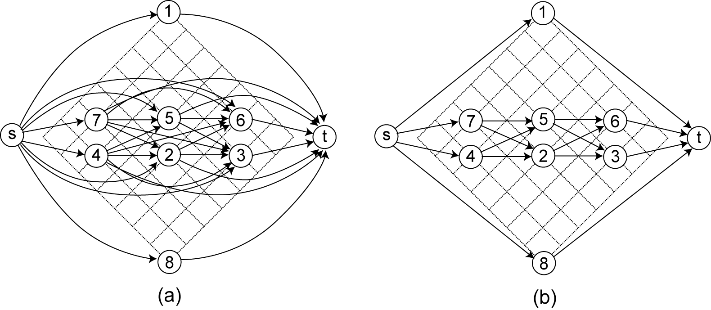
Horizontal Constraint Graph (cont’d)
Transitive reduction
Notes:
This slide shows you the result of the horizontal constraint graph for this example. (explain …)
We will also create a super source and a super target that connect all nodes.

Slide 30
Vertical Constraint Graph (VCG)
Add a directed edge m1→m2 if m2 is above module m1
Notes:
Similarly, we will construct another graph called vertical constraint graph that represents the vertical constraints and orders among modules. We will add a directed edge (explain …)

Slide 31
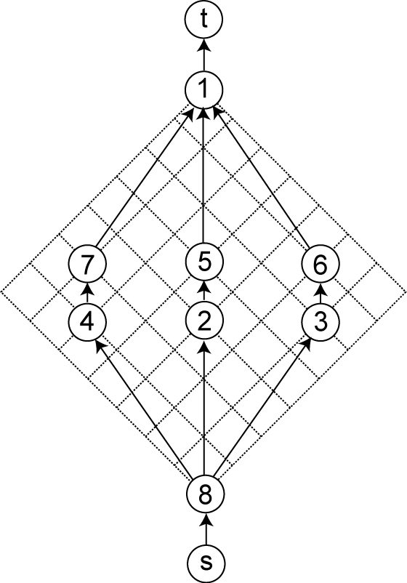
Vertical Constraint Graph (cont’d)
Notes:
This is the simplified vertical constraint graph. (explain …)
Similarly, we will also create a super source and a super target that connect all nodes.

Slide 32
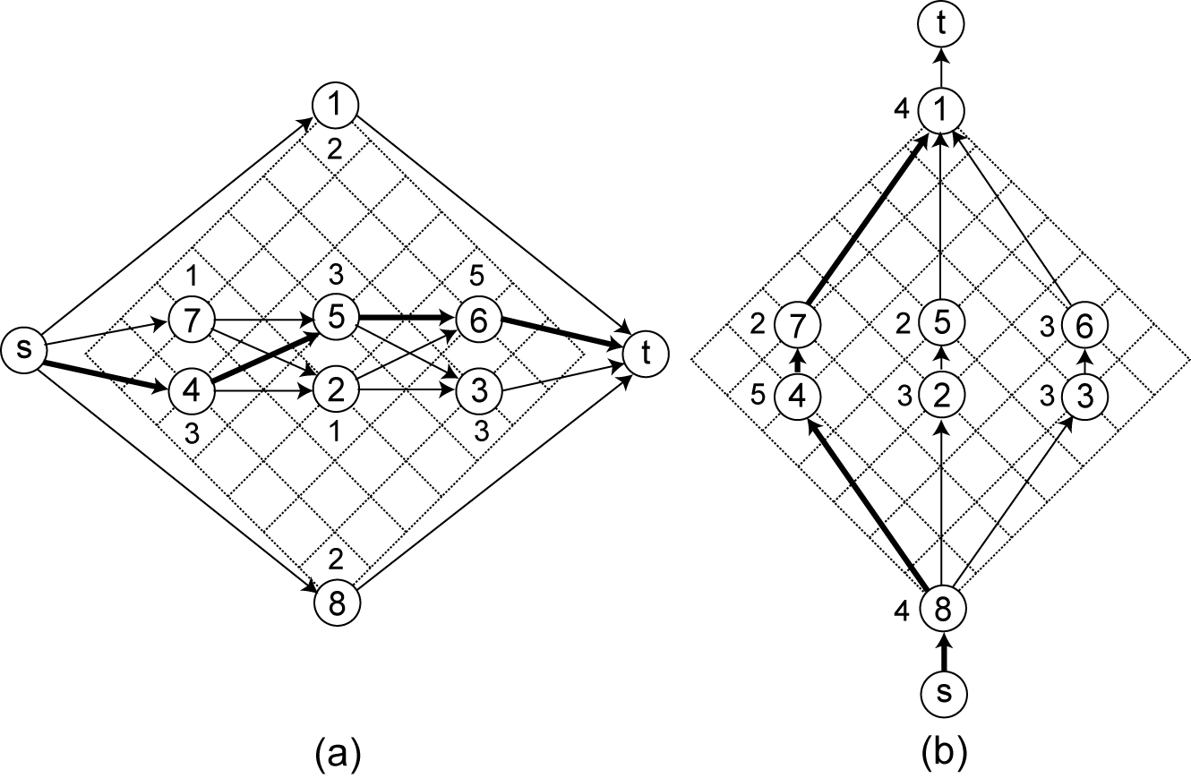
Computing Floorplan Width and Height
Longest s-t path in
HCG: chip width
VCG: chip height
SP = (17452638, 84725361)
Dimensions (W, H): (2,4), (1,3), (3,3), (3,5), (3,2), (5,3), (1,2), (2,4)
Node weight = module width/height!
Notes:
With the two graphs, we assign a node weight equal to the width and height of the module in the horizontal constraint graph and the vertical constraint graph, respectively. For example, (explain …)
Now, the claim is, by finding the longest path from the source to the target, we can determine the chip width and chip height. The longest s-t path from the source to the target in the horizontal constraint graph is the width of the packed floorplan area, and the longest s-t path from the source to the target in the vertical constraint graph is the height of the packed floorplan area.
For instance (explain the two graphs…)

Slide 33
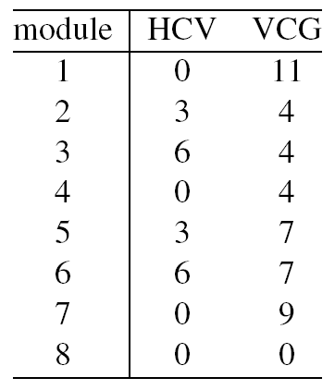
Computing Module Locations
Lower-left corner location maps to the longest path to each module
Notes:
But what about the module locations? Well, the longest path to each module maps to the lower-left corner location of each module. For example, in horizontal constraint graph here, the longest path to module 1 is 0, to module 2 is 3, (explain …)

Slide 34
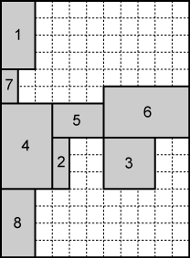
Floorplan Result
11×15
Notes:
Then, we know module 1 is placed at the location (0, 11), module 2 is placed at the location (3, 4) … (explain)

Slide 35
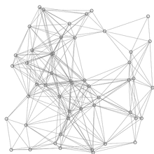
How to Find Longest Paths?
Shortest-path-faster algorithm (SPFA)
Improved version of Bellman-Ford algorithm
Add a minus sign “-” to the edge weight
procedure SPFA(G, s)
1 for each vertex v ≠ s in V(G)
d(v) := ∞
d(s) := 0
push s into Q
while Q is not empty do
u := Q.pop()
for each edge (u, v) in E(G) do
if d(u) + w(u, v) < d(v) then
d(v) := d(u) + w(u, v)
if v is not in Q then
push v into Q
Relaxation happens only at active vertices (in queue) – largely reduced redundant relaxations!
red lines are shortest path covering blue lines are relaxations
Notes:
How do we find longest paths? Well, last week, we have talked about shortest path algorithms, right? (explain…)

Slide 36
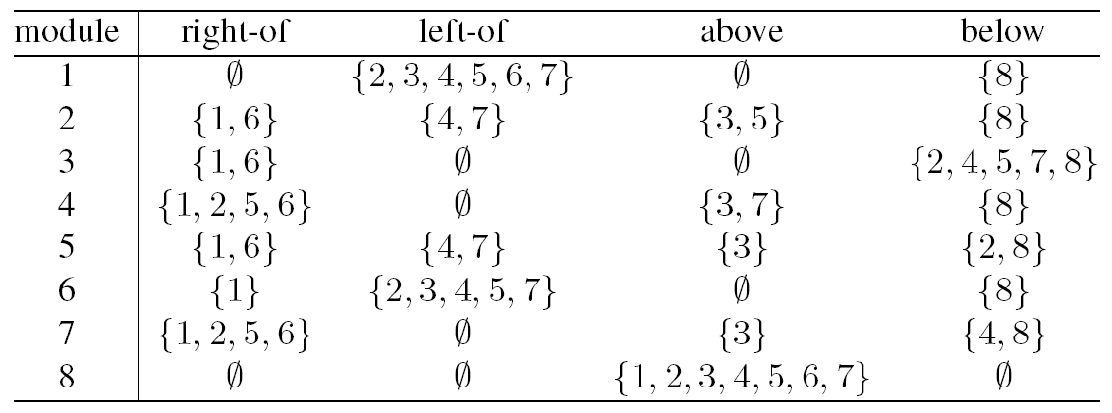
Move 1
Swap 1 and 3 in positive sequence of SP₁
SP₁ = (17452638, 84725361); SP₂ = (37452618, 84725361)
Notes:
Now we know how to construct or recover the floorplan from a sequence pair to decide the module locations and the packed area. We can start applying our moves to change the sequence pair to optimize the floorplan. For example, using move #1, we can swap 1 and 3 in positive sequence and that result in a new floorplan result, and we will update the table of relative orders among modules. (explain …)

Slide 37
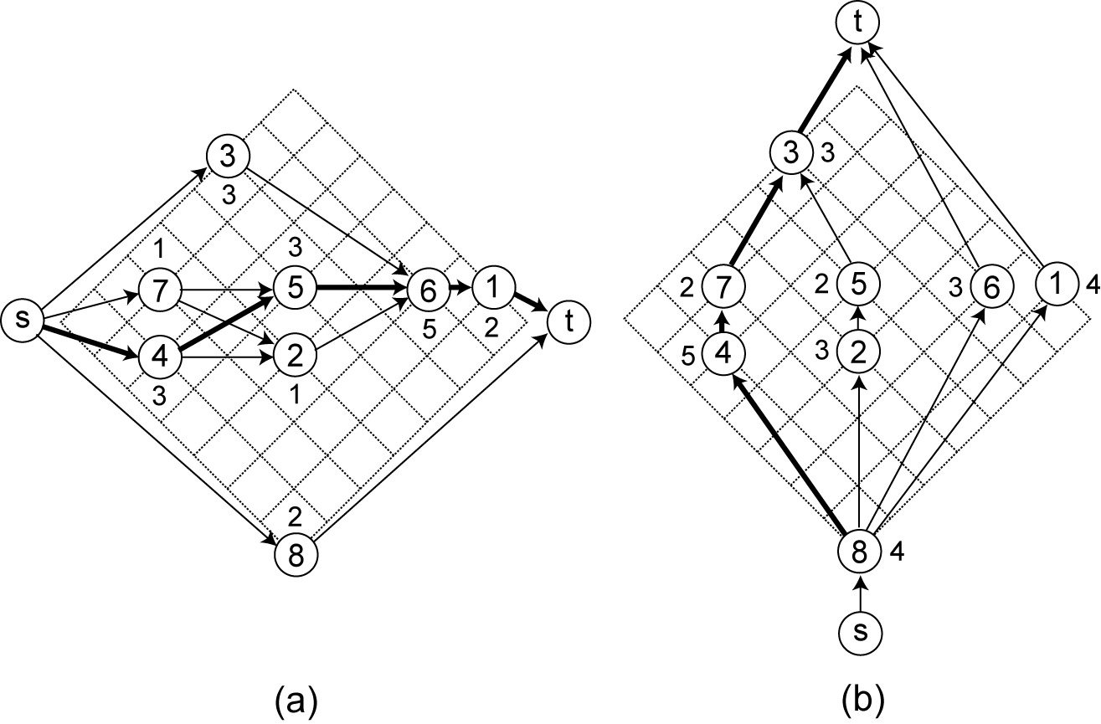
Constraint Graphs after Move 1
Notes:
Similarly, we will update the constraint graph after such moves, and then we recalculate the longest path distance to decide the module locations and chip area.

Slide 38
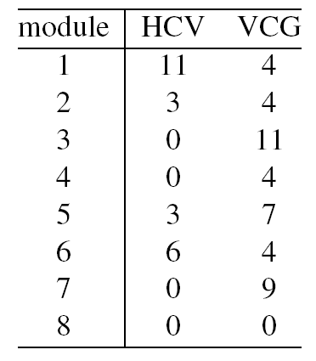
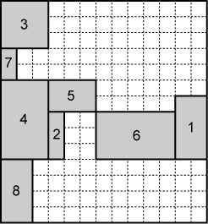
Constructing Floorplan after Move 1
13×14
Notes:
After this move, we end up with this new floorplan with a new area of 13 by 14.

Slide 39
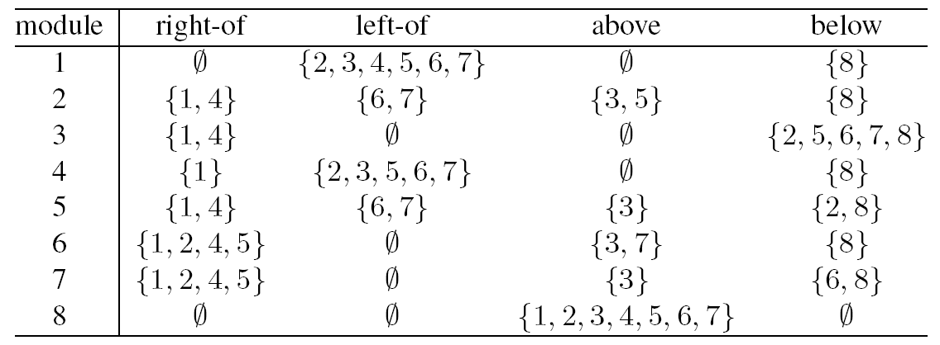
Move 2
Swap 4 and 6 in both sequences of SP₂
SP₂ = (37452618, 84725361); SP₃ = (37652418, 86725341)
Notes:
(explain …)

Slide 40
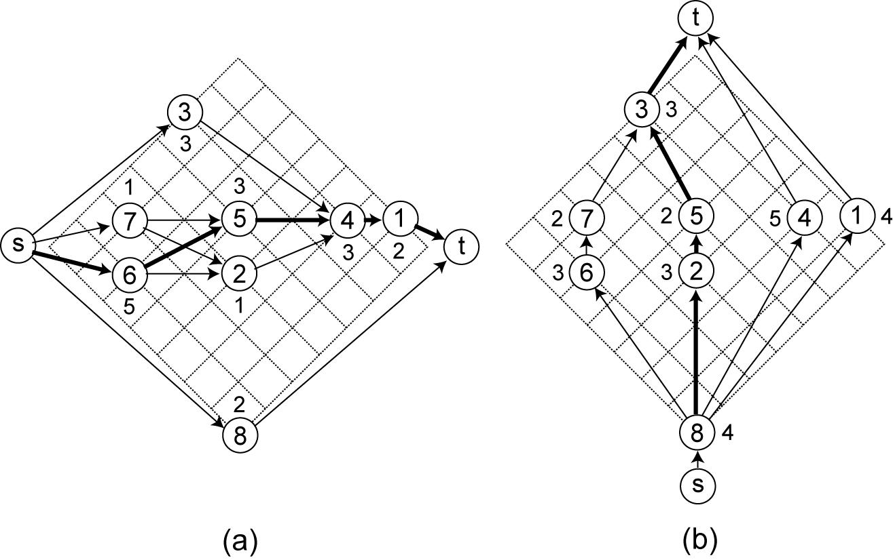
Constraint Graphs after Move 2

Slide 41
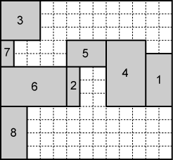
Constructing Floorplan after Move 2
13×12

Slide 42
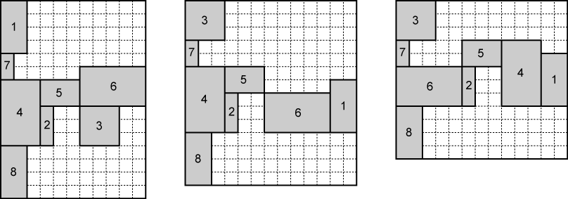
Impacts of Move 1 and Move 2
Floorplan dimension changes from 11×15 to 13×14 to 13×12
Notes:
As you can see, we iteratively apply these moves to change the layout of floorplan, and over the iterations we will pick up the one with the minimum area. In this case, after move 1, we change the area from 11 x 15 to 13 by 14, and after move 2, we change the area from 13 by 14 to 13 by 12. And the final floorplan has the smallest area of 13 by 12.

Slide 43
Simulated Annealing (SA) Algorithm
1 begin
2 Get an initial solution S;
3 Get an initial temperature T > 0;
4 while not yet “frozen” do
5 for 1 i P do
6 Pick a random neighbor S’ of S;
7 △← cost(S’) – cost(S); /* down hill move */
8 if △ 0 then S←S’ /* uphill move */
9 if △ > 0 then S←S’ with probability;
10 T←rT ; /* reduce temperature */
11 return S
12 end
T_{i} = αT_{i-1} where α=0.85
At T_{i}, try k × n moves
k is around 5 to 10
Stop the annealing when
# of accepted moves < 5%
or the temperature is low
or until a max # of iterations
Cost metric: αA + βL
Area + Wirelength
Notes:
And keep in mind, we will apply SA to optimize this process.

Slide 44
Programming Assignment #2
Implement a fix-outline floorplanning algorithm
https://github.com/tsung-wei-huang/ece5960-physical-design/tree/main/PA2
Two checkpoint dues, 10/5 and 10/19 23:59 PM
https://github.com/tsung-wei-huang/ece5960-physical-design/issues/2
Final Due on 10/26 (Wed) 23:59 PM
Upload your solutions to twhuang-server-01.ece.utah.edu
Account: ece6960-fall22
Place your source code + README under PA2/your_uid/
README should contain instruction to compile & run your code

Slide 45
Programming Assignment #2 (cont’d)
In addition to source code + README, upload a report with:
A table showing your results of each benchmark
A section discussing what challenges you encounter
A section discussing how you overcome those challenges
Also discuss unsolved challenges
The report needs to be just a one- or two-page pdf
No need to be lengthy …
Upload your report to the class GitHub page
https://github.com/tsung-wei-huang/ece5960-physical-design/issues/3
Due 10/26 23:59 PM

Slide 46
In-class Presentation: 10/19
Floorplan research presentation on 10/19 (in class)
Xiaoping Tang and D. F. Wong, "FAST-SP: a fast algorithm for block placement based on sequence pair," IEEE/ACM Asia and South Pacific Design Automation Conference, 2001
Jackey Z. Yan and Chris Chu, “DeFer: Deferred Decision Making Enabled Fixed-Outline Floorplanning Algorithm,” IEEE Trans. Comput. Aided Des. Integr. Circuits Syst. 29(3): 367-381, 2010
Upload your pptx to https://github.com/tsung-wei-huang/ece5960-physical-design/issues/10 before presentation

Slide 47
Summary
We have discussed sequence pair floorplan optimization
Positive and negative sequences to describe module locations
Can represent generic floorplan (non-slicing layout)
We have discussed floorplan recovery from sequence pair
Horizontal constraint graph (HCG)
Vertical constraint graph (VCG)
Longest path in HCG represents the floorplan width
Longest path in VCG represents the floorplan height

